Slide 1

6th Grade Accelerated Math
Unit 3, Lesson 1 Rational Numbers and the Number Line – Part 1 Volume 1, pg. 75

Slide 2


Benchmark
MA.6.NSO.1.1
Extend previous understanding of numbers to define rational numbers. Plot, order, and compare rational numbers.
MA.6.NSO.1.2
Given a mathematical or real-world context, represent quantities that have opposite direction using rational numbers. Compare them on a number line and explain the meaning of zero within its context.
volume 1, pg. 75

Slide 3
Integrated Mathematical Thinking and Reasoning Standards
MA.K12.MTR.1.1 Actively participate in effortful learning both individually and collectively.
MA.K12.MTR.4.1 Engage in discussions that reflect on the mathematical thinking of self and others.
MA.K12.MTR.5.1 Use patterns and structure to help understand and connect mathematical concepts.
volume 1, pg. 75

Slide 4

Learning Targets
I can demonstrate an understanding of negative numbers.
I can recognize that a number in the real number system can have a variety of classifications.
I can plot rational numbers on a horizontal and vertical number line.
volume 1, pg. 75

Slide 5

Warm-Up
volume 1, pg. 75

Slide 6
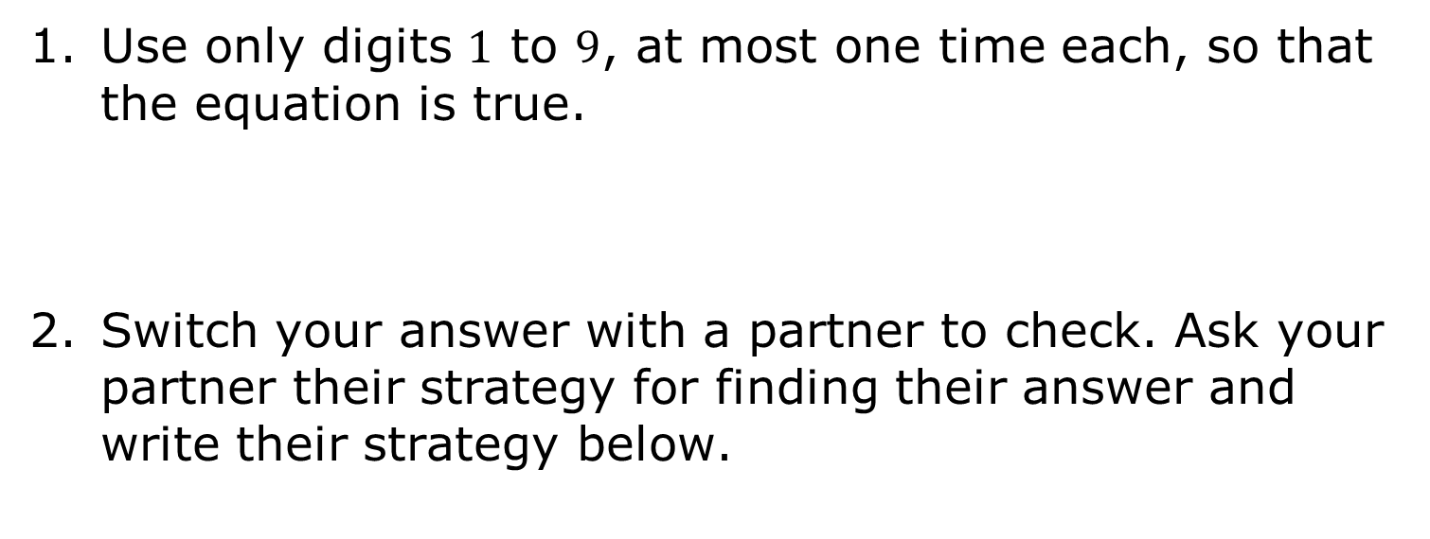
3.1.1 Warm-Up: Creating Zero
Use only digits $1$ to $9$, at most one time each, so that the equation is true.
Switch your answer with a partner to check. Ask your partner their strategy for finding their answer and write their strategy below.
volume 1, pg. 75

Slide 7

Exploration
volume 1, pg. 76

Slide 8

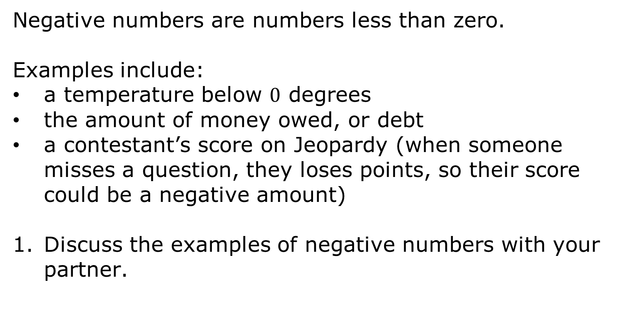
3.1.2 Exploration: How Can Negative Numbers Exist?
Negative numbers are numbers less than zero.
Examples include:
a temperature below $0$ degrees
the amount of money owed, or debt
a contestant’s score on Jeopardy (when someone misses a question, they loses points, so their score could be a negative amount)
Discuss the examples of negative numbers with your partner.
volume 1, pg. 76

Slide 9
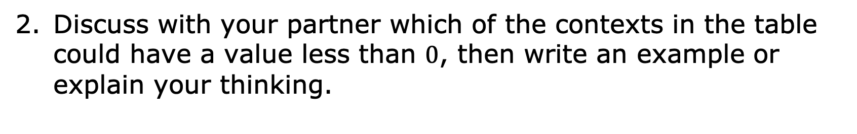
Discuss with your partner which of the contexts in the table could have a value less than $0$, then write an example or explain your thinking.
Context | Example or Explanation
Direction
Points in a game
Time
volume 1, pg. 76

Slide 10

Guided Instruction
volume 1, pg. 76

Slide 11


3.1.3 Guided Instruction: The Real Number System
The values in blue on the number line are some of the numbers in the set of natural numbers.
Natural numbers are the counting numbers $\{1, 2, 3, 4, 5…\}$.
volume 1, pg. 76

Slide 12

The values in red on the number line are some of the numbers in the set of whole numbers.
Whole numbers are natural numbers and zero. $\{0, 1, 2, 3, 4, 5…\}$
volume 1, pg. 76

Slide 13


The values in green on the number line are some of the values in the set of integers.
Integers are whole numbers and their opposites.
$\{…−4, −3, −2, −1, 0, 1, 2, 3, 4…\}$
volume 1, pg. 76

Slide 14
Use the number lines to help to answer each of the following questions.
What do you notice about the set of natural numbers and the set of whole numbers?
What do you notice about the set of integers?
volume 1, pg. 77

Slide 15
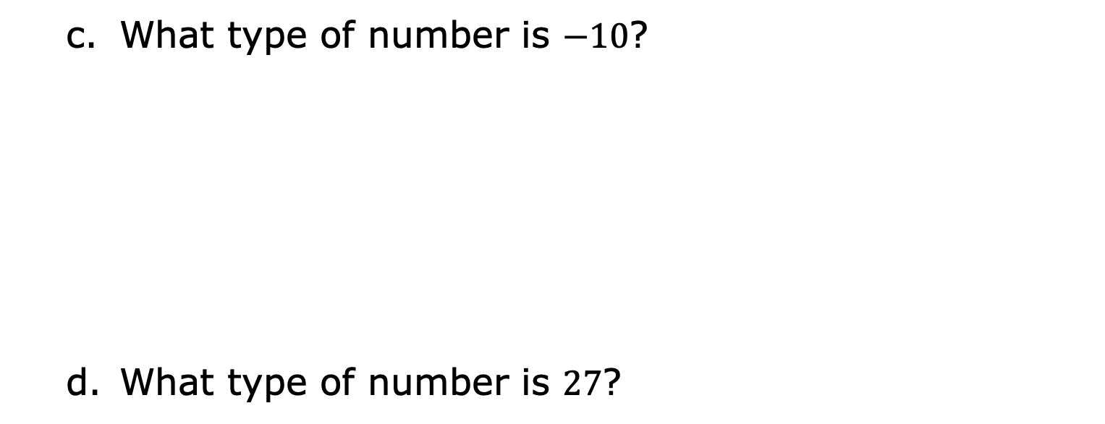
What type of number is $−10$?
What type of number is $27$?
volume 1, pg. 77

Slide 16
Describe the numbers that appear in all three sets.
volume 1, pg. 77

Slide 17
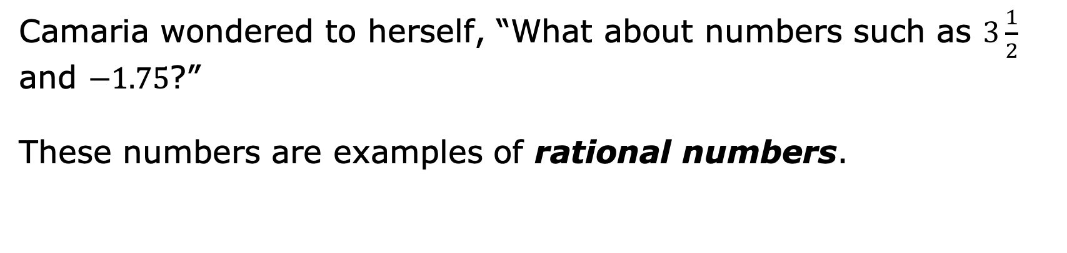
Camaria wondered to herself, “What about numbers such as $3\frac{1}{2}$ and $−1.75$?”
These numbers are examples of rational numbers.
Rational numbers are numbers that can be expressed as the ratio of two integers.
volume 1, pg. 77

Slide 18
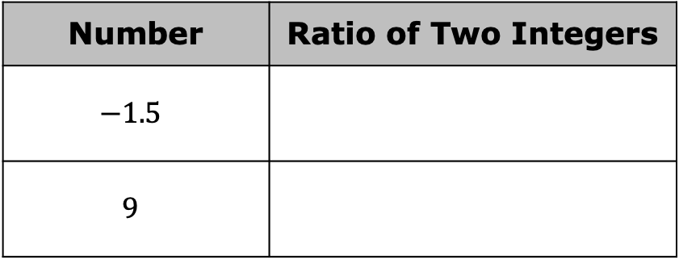
Use the definition of rational numbers to write each as a ratio of two integers.
In your study of mathematics, you will learn about irrational numbers, which are numbers that cannot be written as a ratio of two integers.
Number | Ratio of Two Integers
$$−1.5$$
$$9$$
The set of real numbers is the set of all rational and irrational numbers.
volume 1, pg. 77

Slide 19

Activity
volume 1, pg. 78

Slide 20

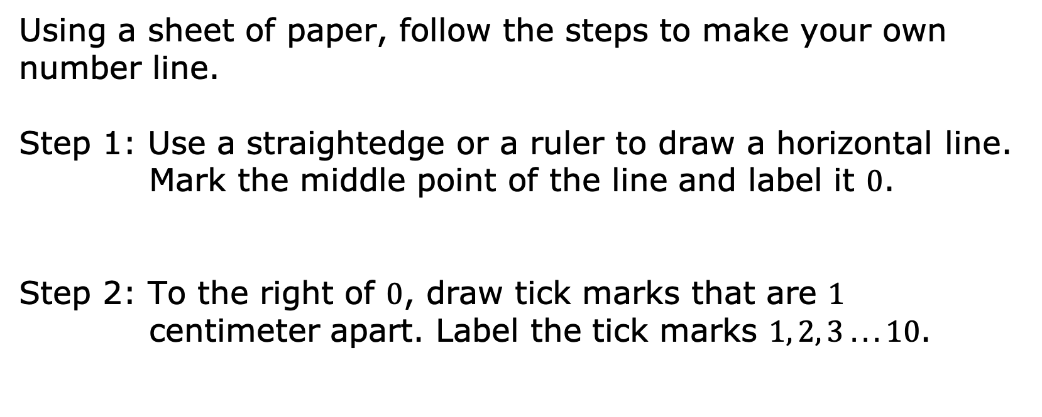
3.1.4 Activity: Horizontal Number Line
Using a sheet of paper, follow the steps to make your own number line.
Step 1: Use a straightedge or a ruler to draw a horizontal line. Mark the middle point of the line and label it $0$.
Step 2: To the right of $0$, draw tick marks that are $1$ centimeter apart. Label the tick marks $1, 2, 3 . . . 10$.
volume 1, pg. 78

Slide 21
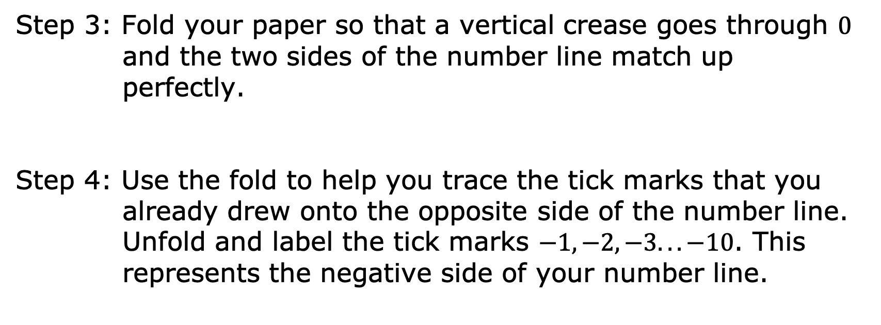
Step 3: Fold your paper so that a vertical crease goes through $0$ and the two sides of the number line match up perfectly.
Step 4: Use the fold to help you trace the tick marks that you already drew onto the opposite side of the number line. Unfold and label the tick marks $−1, −2, −3. . . −10$. This represents the negative side of your number line.
volume 1, pg. 78

Slide 22
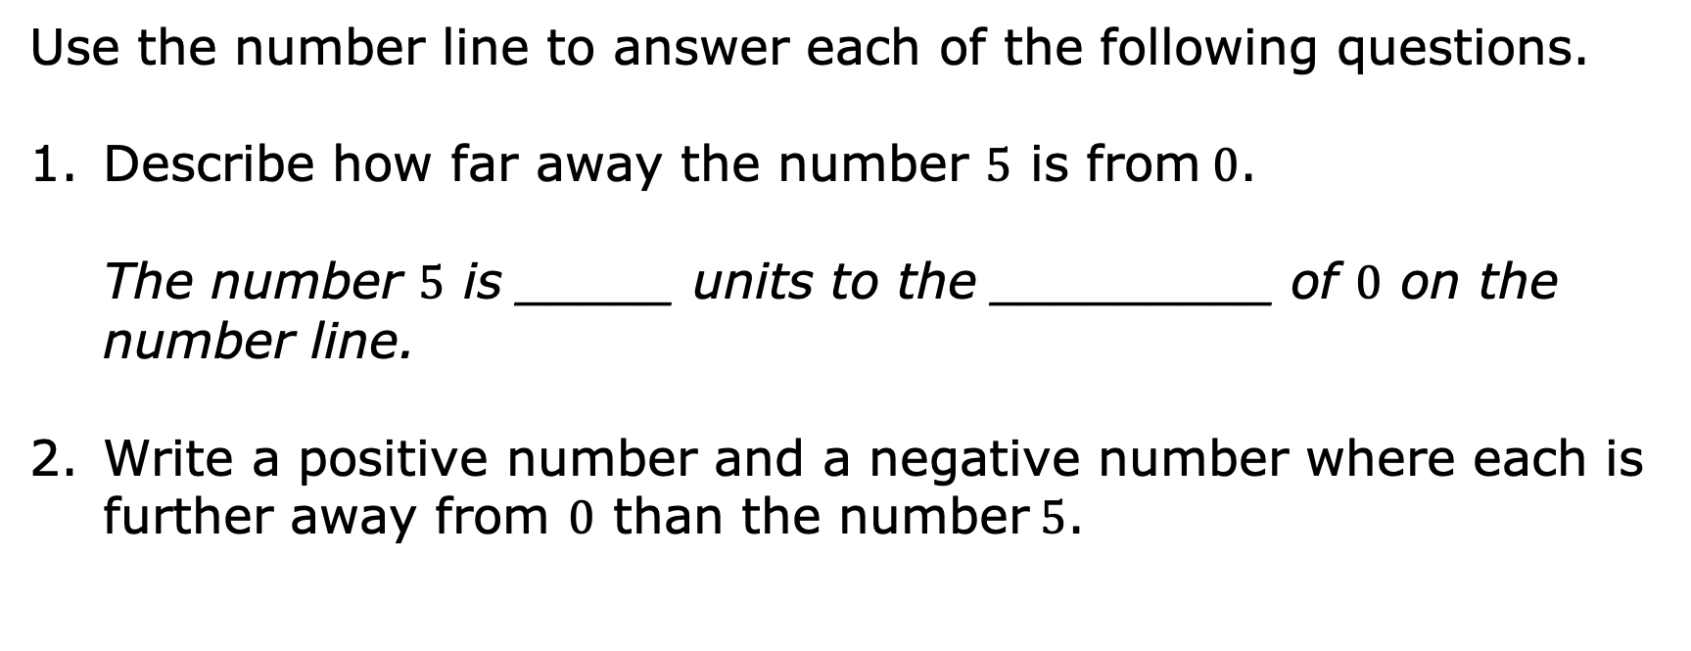
Use the number line to answer each of the following questions.
Describe how far away the number $5$ is from$0$.
The number $5$ is _____ units to the _________ of $0$ on the number line.
Write a positive number and a negative number where each is further away from $0$ than the number$5$.
volume 1, pg. 78

Slide 23
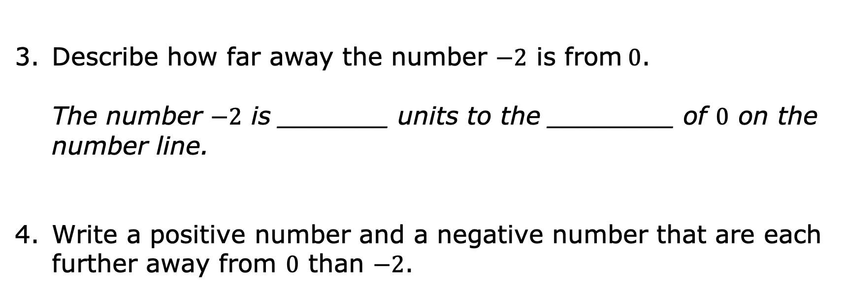
Describe how far away the number $−2$ is from$0$.
The number $−2$ is _______ units to the ________ of $0$ on the number line.
Write a positive number and a negative number that are each further away from $0$ than $−2$.
volume 1, pg. 78

Slide 24

Bring It Together
volume 1, pg. 79

Slide 25

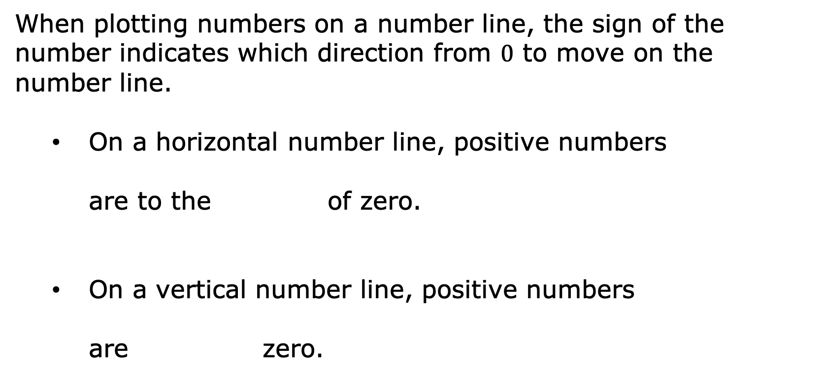
3.1.5 Bring It Together: Plotting Rational Numbers on Number Lines
When plotting numbers on a number line, the sign of the number indicates which direction from $0$ to move on the number line.
On a horizontal number line, positive numbers
are to the of zero.
On a vertical number line, positive numbers
are zero.
right
left
above
below
volume 1, pg. 79

Slide 26
On a horizontal number line, negative
numbers are to the of zero.
On a vertical number line, negative numbers
are zero.
right
left
above
below
volume 1, pg. 79

Slide 27

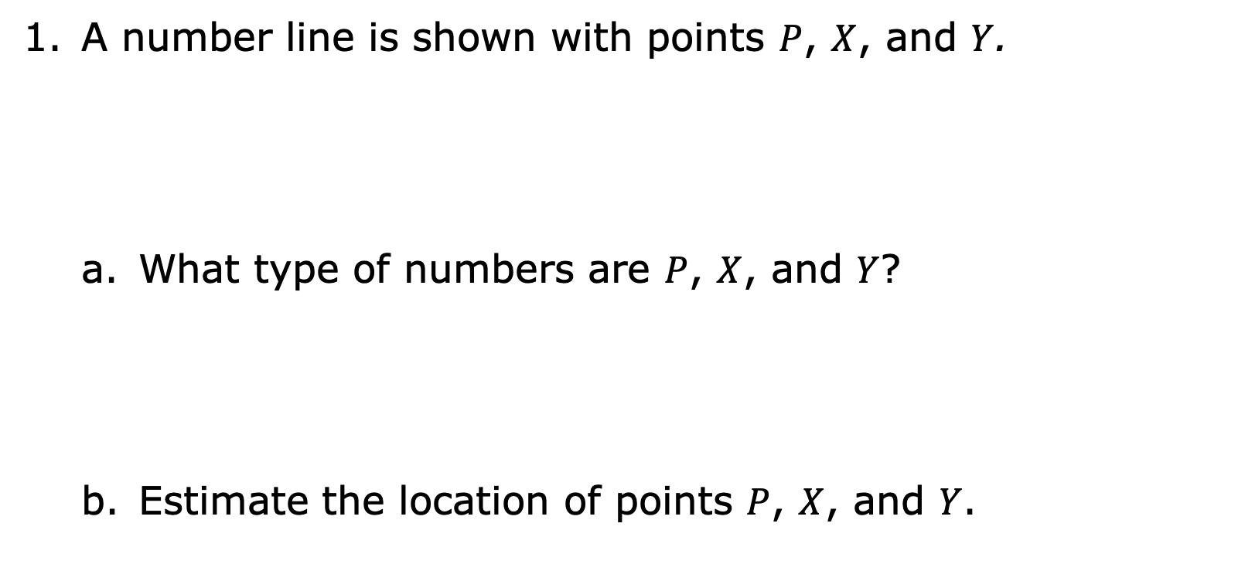
A number line is shown with points $P$, $X$, and $Y$.
What type of numbers are $P$, $X$, and $Y$?
Estimate the location of points $P$, $X$, and $Y$.
volume 1, pg. 79

Slide 28
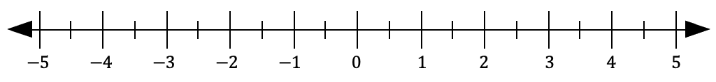
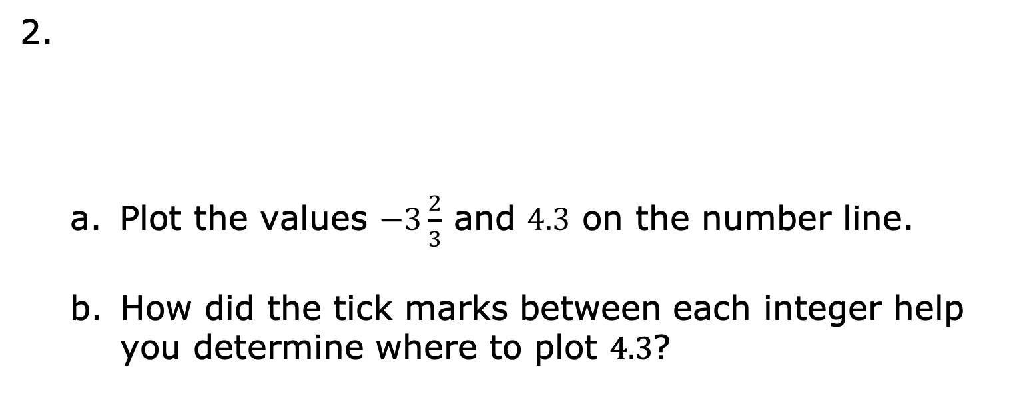
Plot the values $−3\frac{2}{3}$ and $4.3$ on the number line.
How did the tick marks between each integer help you determine where to plot $4.3$?
volume 1, pg. 79

Slide 29

How did the tick marks between each integer help you determine where to plot $−3\frac{2}{3}$?
volume 1, pg. 79

Slide 30
On the number line, make a tick mark that is halfway between each value on the number line. Label each tick mark with the value of its location.
volume 1, pg. 80

Slide 31
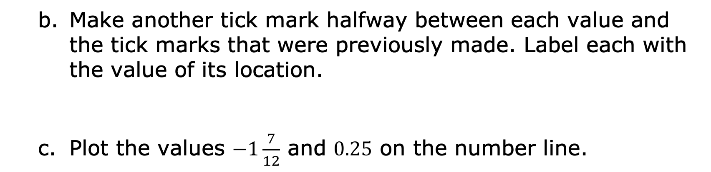
Make another tick mark halfway between each value and the tick marks that were previously made. Label each with the value of its location.
Plot the values $−1\frac{7}{12}$ and $0.25$ on the number line.
volume 1, pg. 80

Slide 32

Try It
volume 1, pg. 80

Slide 33

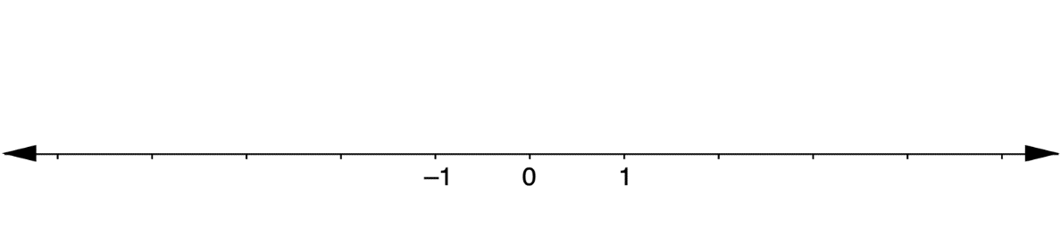
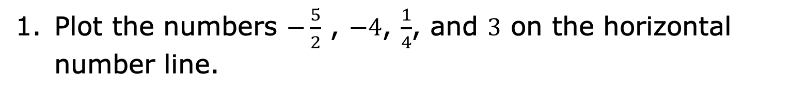
3.1.6 Try It: Plotting Rational Numbers on a Number Line
Plot the numbers $−\frac{5}{2}$ , $−4$, $\frac{1}{4}$, and $3$ on the horizontal number line.
volume 1, pg. 80

Slide 34
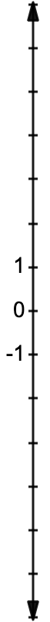
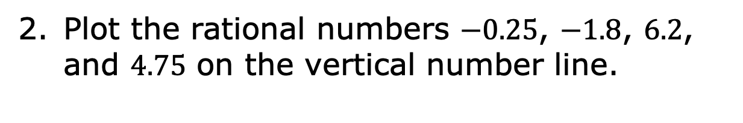
Plot the rational numbers $−0.25$, $−1.8$, $6.2$, and $4.75$ on the vertical number line.
volume 1, pg. 80

Slide 35

Your Turn
volume 1, pg. 81

Slide 36
3.1.7 Your Turn!
greater
less
Negative numbers are than zero. On
a horizontal number line, negative numbers are
to the of zero. On a vertical number
line, negative numbers are zero.
right
left
above
below
volume 1, pg. 81

Slide 37
Plot the integers $2$, $−3$, $0$, $−5$ and $5$ on the horizontal number line.
volume 1, pg. 81

Slide 38
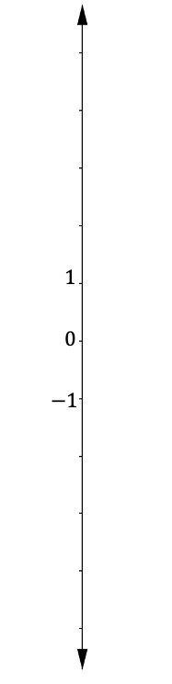
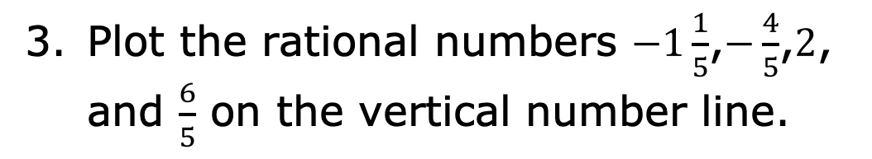
Plot the rational numbers $−1\frac{1}{5}$,$−\frac{4}{5}$,$2$, and $\frac{6}{5}$ on the vertical number line.
volume 1, pg. 81

Slide 39

Wrap-Up
volume 1, pg. 81

Slide 40
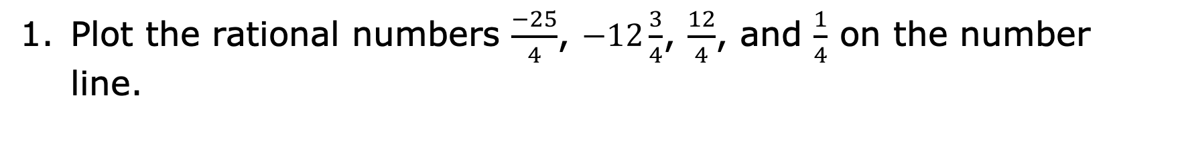
3.1.8 Wrap-Up: Ticket Out the Door
Plot the rational numbers $\frac{−25}{4}$, $−12\frac{3}{4}$, $\frac{12}{4}$, and $\frac{1}{4}$ on the number line.
volume 1, pg. 81

Slide 41

Explain how to estimate the value of $G$.
volume 1, pg. 81

